Slide 1


Introduction to Wellbeing
Learn what decades of evidence-based research has revealed about wellbeing

Slide 2

Course Objectives
01
After taking this course participants will understand the research that supports the Mindful Active Purposeful Living Wellbeing Program.
02
Participants will have a baseline understanding of key definitions related to health, illness, wellness and wellbeing.
03
Learners will have a solid foundation to start and/or enhance their wellbeing journey as they move through this program.

Slide 3
Foundational Definitions For The Program
Health, Wellness and Wellbeing are words that are used interchangeably. Below are the working definitions utilized throughout this program. It is also key to know the difference in mental and physical health and illness.
Health | Traditionally physical and mental disease prevention.
Wellness | Traditionally proactive focus on a lifestyle with activates and behaviors that create optimal physical and mental health.
Wellbeing | A life well lived with a comprehensive focus on numerous components of wellness that create peace and happiness if life.
Mental/Physical Illness | Being diagnosed with a mental or physical disease or disorder by traditional medical definitions and standards. Examples, bi-polar disorder and hearth disease.
Mental/Physical Health | Physically and mentally, you can be unhealthy at any given time without having a diagnosed condition. Research actually shows you there are more daily instances of mental unhealthiness than physical.

Slide 4











Did You Know
There are Doctors, Scientists, Nutrition, Fitness Experts, and companies in almost every country in the world that are studying how to make each and everyone one of us the best we can be as human beings.
What did they find out?
They are confirming some really cool things about all human beings. You may be taller, shorter, boy, girl, brown hair, blond hair, and so very different externally which is what makes us so interesting, unique, and beautiful. There is so much about us that is the same internally. When we really understand that it leads to better wellbeing for the world.
.
America
At Home Study
What is the Same?
Think about this, a boy and a girl both need to breath, right? A brown eyed person and a blue-eyed person both need to eat food and drink water right? We all have eyes, noses, arms, legs, brains, stomachs, right?
Notes:
13-18

Slide 5
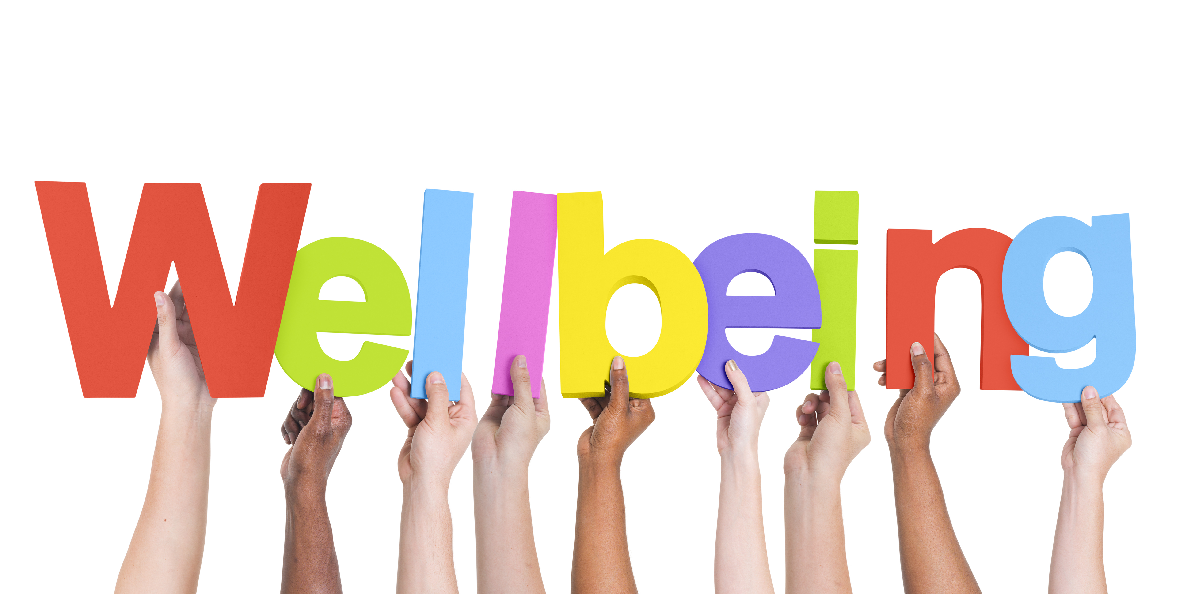
Various wellness institutes have taken this research and created different facets of wellbeing that apply to all humans.
The facets involve: intellect, emotions, mental, mind, physical, body, spirit, community, organization, occupation, vocation, finances, rest and play, self care, social relationships, and heart.
The manner in which professional wellness and wellbeing organizations title and put these into facets into their programs varies based on audience.
MAP Living organized all of these key facets into our six-facet program.

Slide 6

Mindful Active Purposeful Living
Mind
Body
This facet covers learning, and goal setting coping and emotions, recovery, in the journey for mental capacity. Learn to the be MINDFUL, take ACTION, and Cop with Daily Life .
Mind
Body
This facet covers physical health through nutrition, exercise, and mind-body connection. Learn FITNESS facts, benefits from the UNITY of Mind and Body, and the truth about NUTRITION.
Spirit
Spirit or
Purpose
Social
This facet covers purpose in life. Learn to CONNECT something greater than self understand individual and shared human value for ACCEPTANCE, live in PEACE regardless of circumstance.
Wellbeing
Social & Community
This facet covers seeking and developing supportive relationships. Learn to implement CARE for self and others, to be OPEN in communications and thinking to better RELATE in the world.
Occupational
Occupational
Finances
Finances
Enjoy where you work, or what you do, organization of life, planning that leads to productivity. Learn the best CAREER for you, ASPIRE to higher levels, and build a professional NETWORK.
Savings paths for life and retirement, investments options, functional purchase decisions based on options. Learn to SAVE, EQUIP yourself with knowledge, and TRANSFORM this key life area.
Notes:
We provide robust wellbeing content to support the mentor-mentee relationship through this eLearning platform with fun and educational courses and content.

Slide 7

Health versus Illness
01
This program is intentional in starting with you at a young age keeping in mind the factors that impact adulthood.
02
The focus is to prevent illness that can actually plague any facet of life. You can be physically ill, mentally ill, financially ill, professionally ill, etc.
03
This journey address practicing healthiness in all of these facets before illness can set in. All facets not just one or two, thus preventing friction creating a life well lived.

Slide 8

Let’s Create You Extraordinary Living
You and your mentor will learn together, you and your mentor will have fun together, you and your mentor will create a plan together that is all about your Unique Extraordinary.

